Slide 1

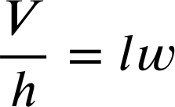
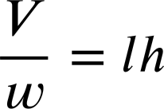
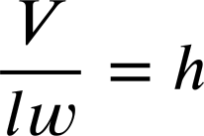
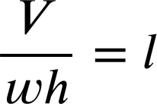
Multiplicative relationships between terms
Task A: The structure of multiplicative relationships
1) Write the family of rearrangements for the below equations.
a)
b)
12 × 7 = 84
0.3 × 2.7 = 0.81
c)
d)
7 × y = 3
d = s × t
2) The volume of a cuboid can be calculated as ‘length × width × height’
Fill in the missing parts of these rearrangements.
V = lwh
h
V, the product of the original multiplicative relationship remained the numerator.
w
l

Slide 2
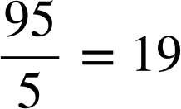
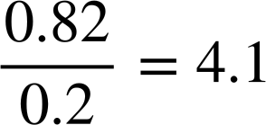


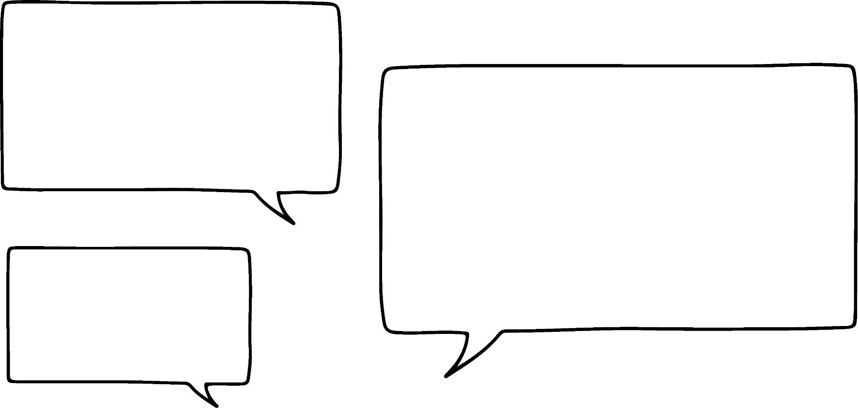







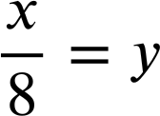
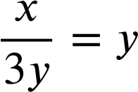
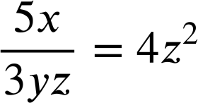
Multiplicative relationships between terms
Task B: Rearranging multiplicative relationships
1) Write the family of rearrangements for the below equations.
a)
b)
c)
d)
2) Lucas is rearranging equations.
I just ‘swap positions’ in the equation.
In each case decide if Lucas is correct and write a sentence to justify your decision.
a)
can swap to
b)
can swap to
c)
can swap to
3) Rearrange each equation into the form a × b = c
a)
b)
c)
Mathematics in Education anf Industry
v2.3

